Slide 1

Roller Rentals

Slide 2
Team Members
Sourav Mondal
Ritam Nayek
Sneha Bhattacharya
Bipasha Laha
Debalina Chakraborty

Slide 3
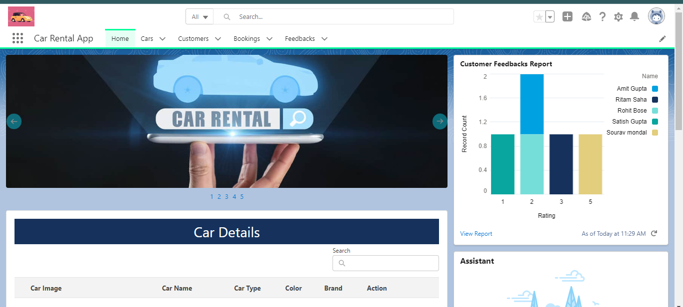
Introduction
Car Rental Company specializing in Renting Cars to customers.
Online system through which customers can view available cars, register, view profiles and book cars.

Slide 4
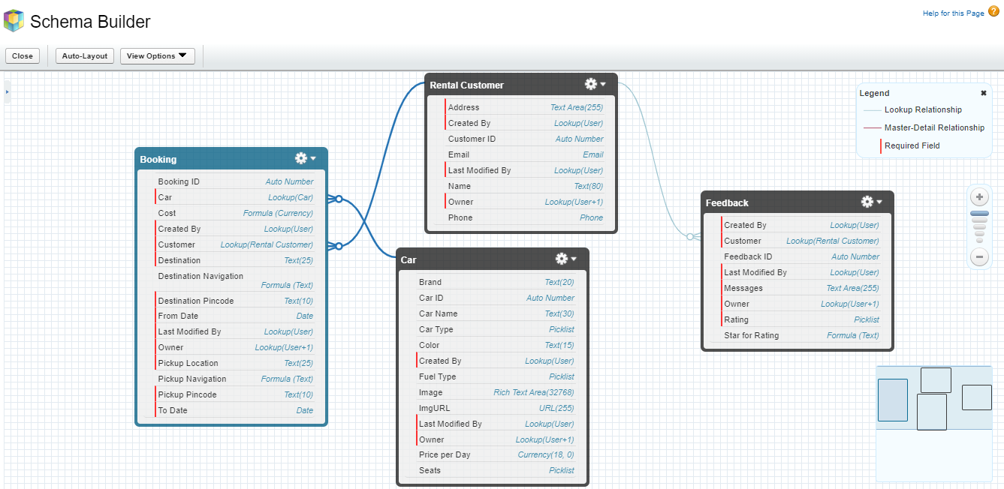
Schema Architecture

Slide 5


Profile
Cloned from System Administrator
Cloned from Standard User

Slide 6
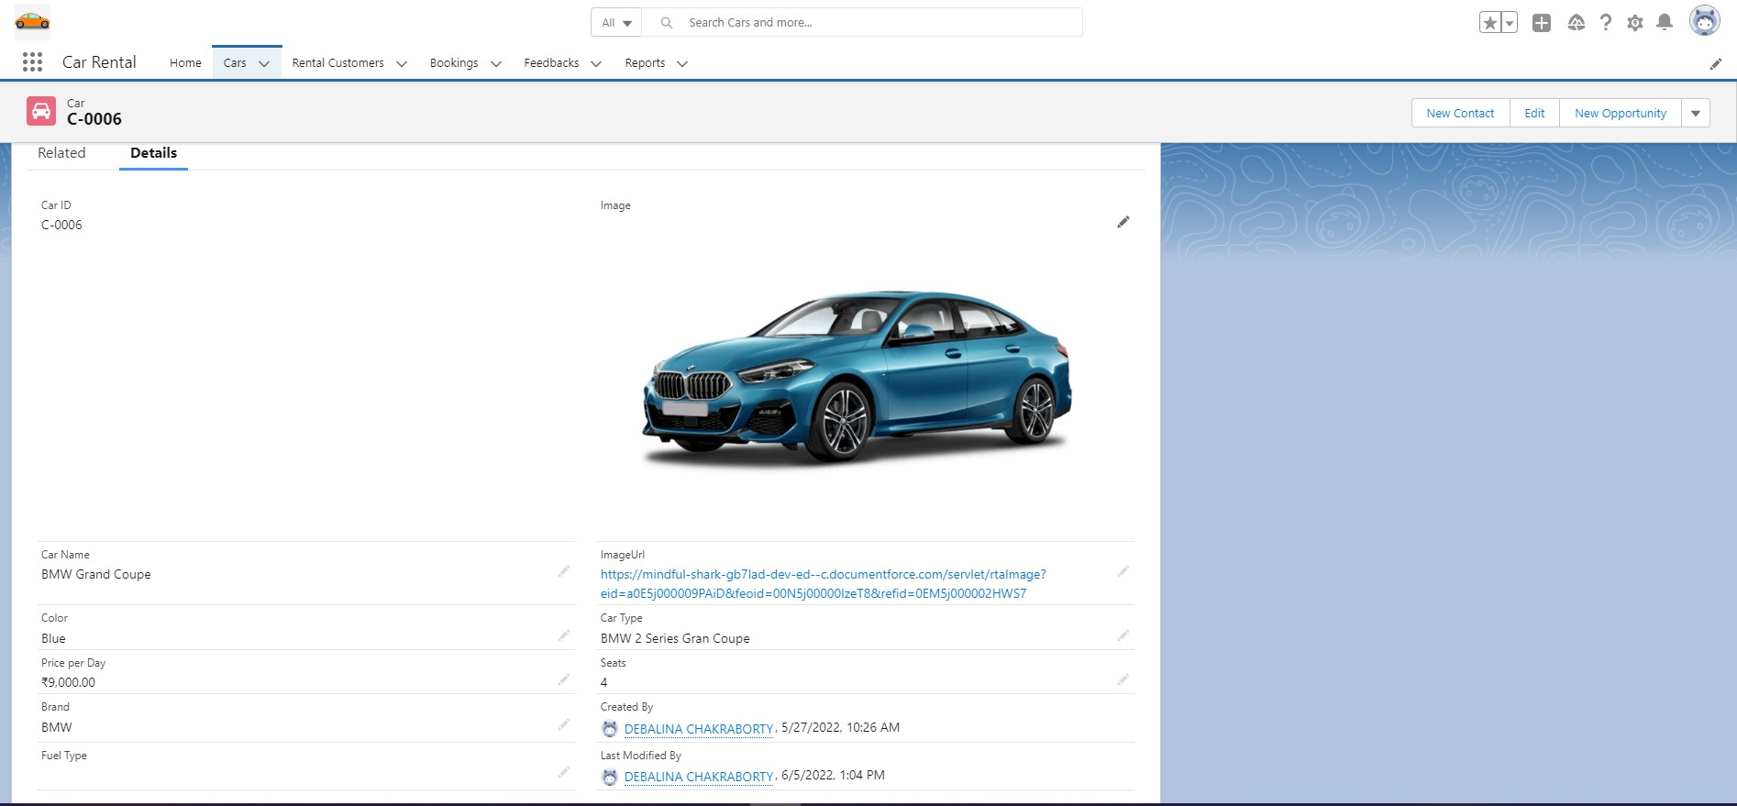
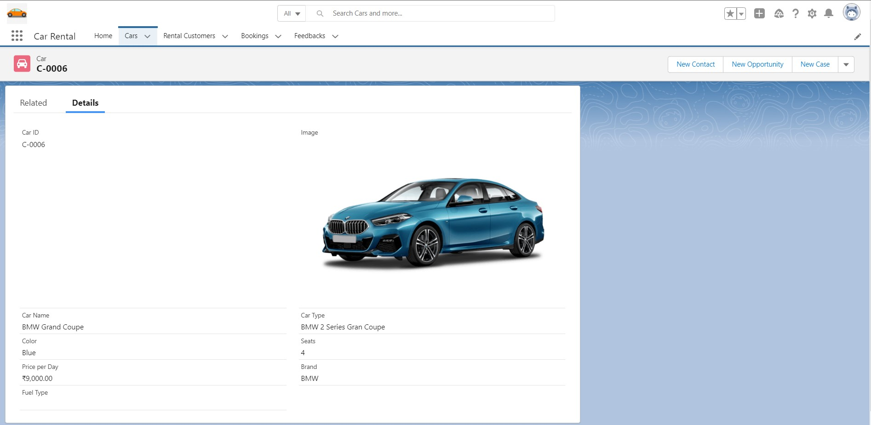
Page Layout
Car Layout for Admin
Car Layout for Customer

Slide 7
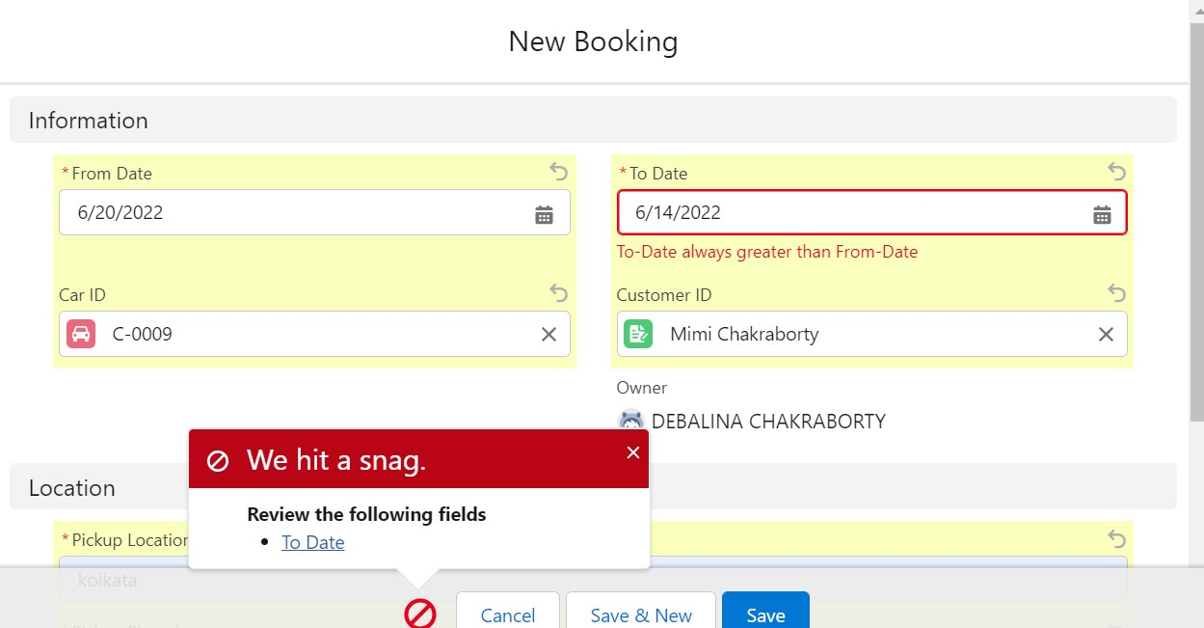
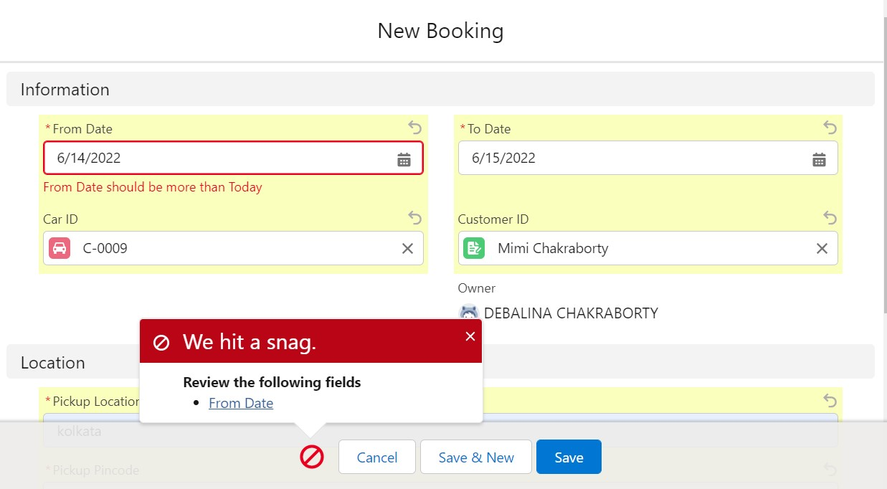
Validations rules
Validation rule to check if ‘To-Date’ is not previous date of ‘From-Date’
Validation rule to check From date should not be Today

Slide 8
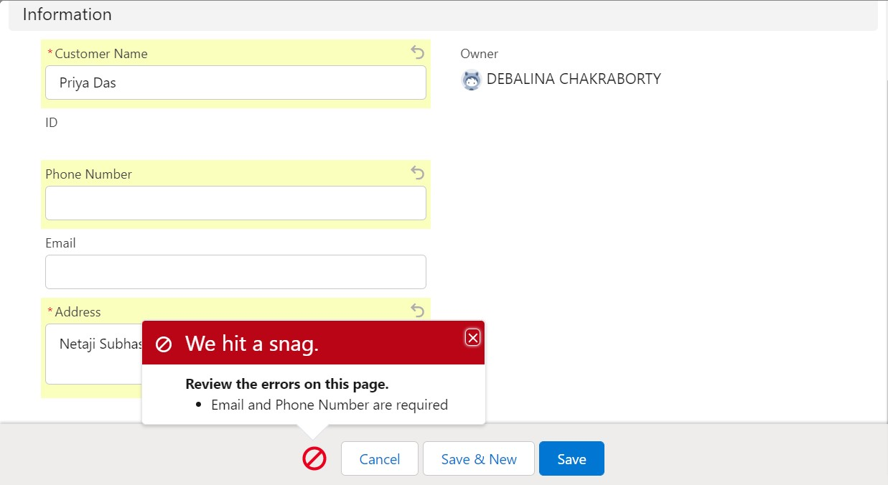
Validations rules (cont.)
Validation rule to make Rental Customer’s Phone and Email mandatory

Slide 9
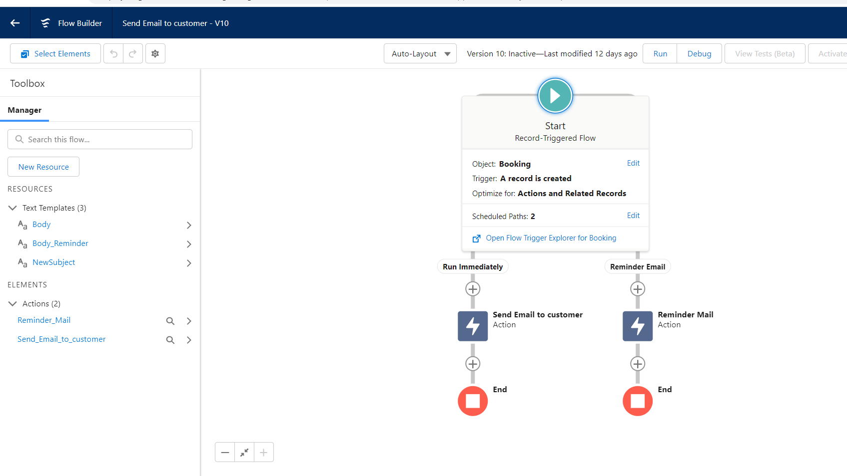
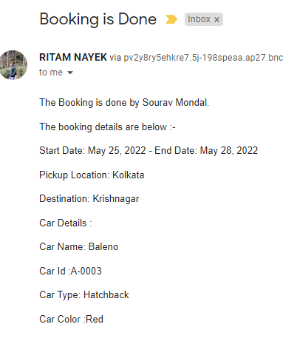
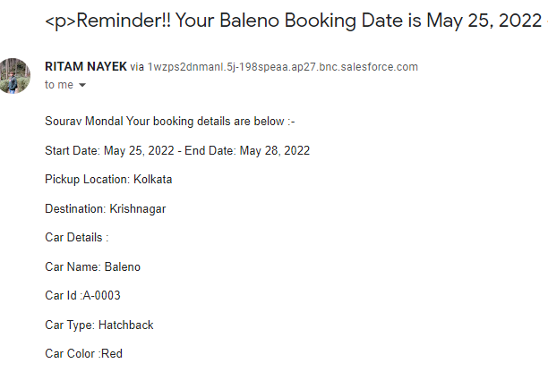
Flows
Send Confirmation and Reminder Mail
Auto generated confirmation email on successful booking.
Auto generated reminder email Before one day of car’s booking date.

Slide 10
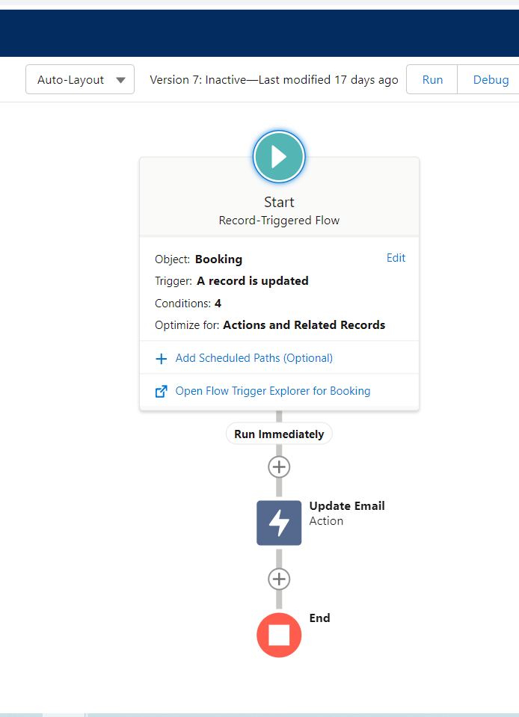
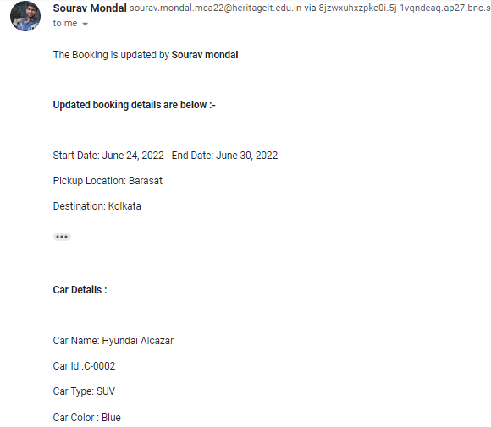
Send Updated Confirmation Mail
Auto generated update confirmation email When a customer change car’s booking details.

Slide 11
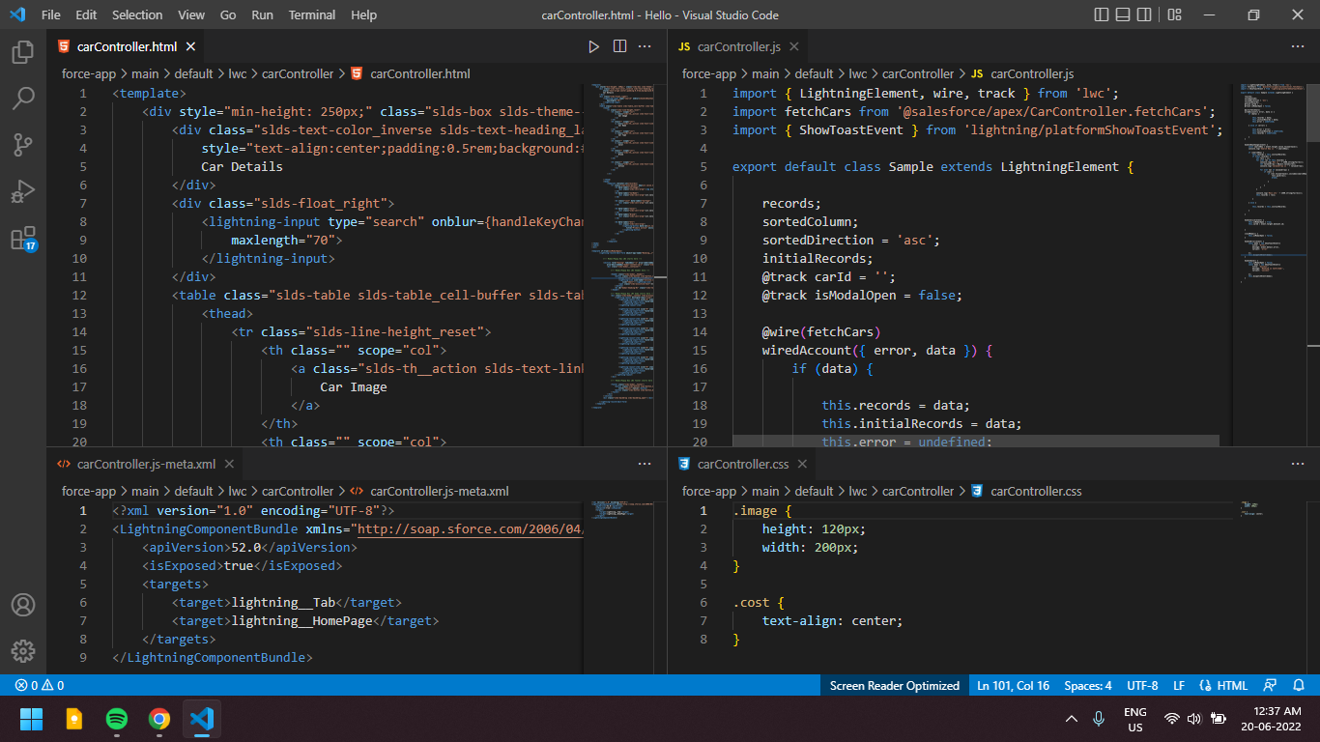
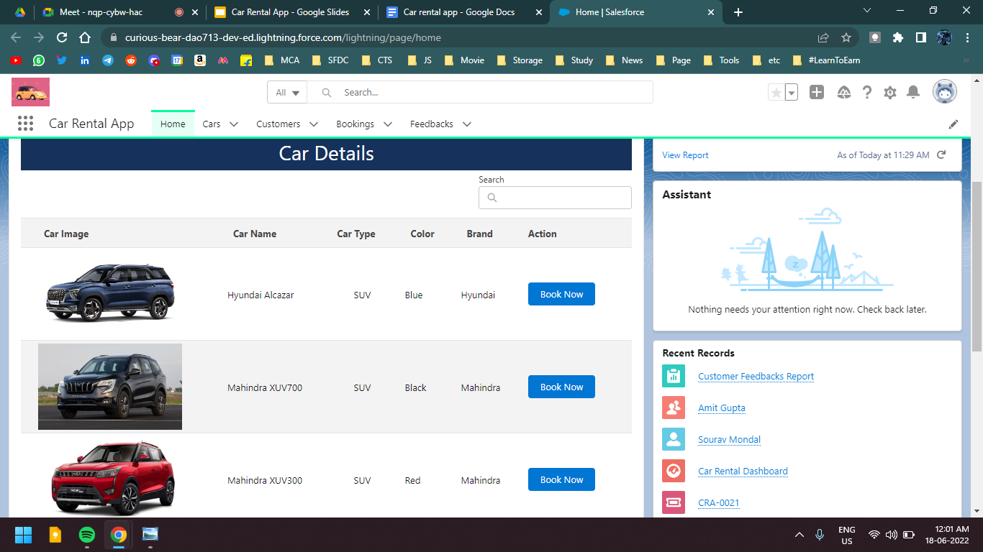
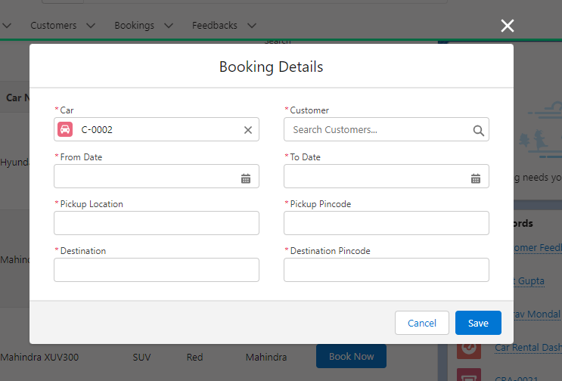
LWC
Custom data-table to show Car details
Custom modal (pop-up) for booking

Slide 12
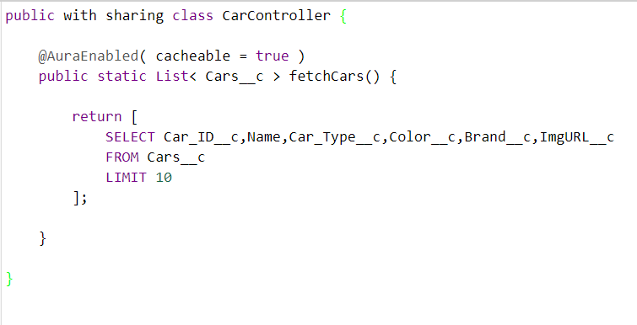
CarController

Slide 13
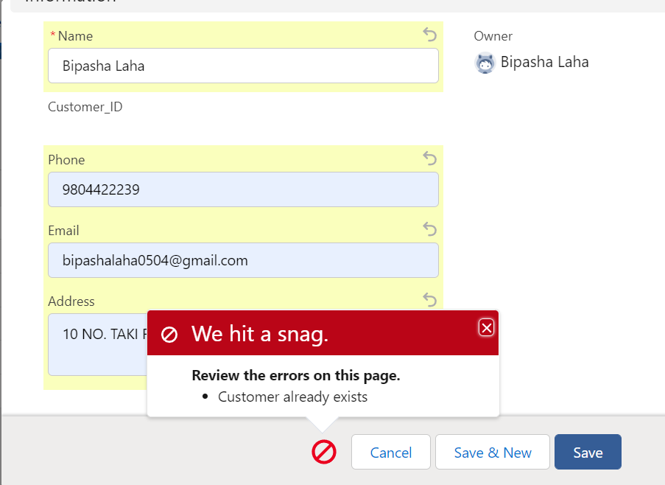
Duplicate Customer
trigger DuplicateCustomer on Rental_Customer__c (before insert) {
for (Rental_Customer__c cd:Trigger.new)
{
List<Rental_Customer__c> mynew = [Select Email__c,Phone__c from Rental_Customer__c where Email__c = : cd.Email__c or Phone__c=: cd.Phone__c];
if(mynew.size()>0)
{
cd.addError('Customer already exists');
}
}
}

Slide 14
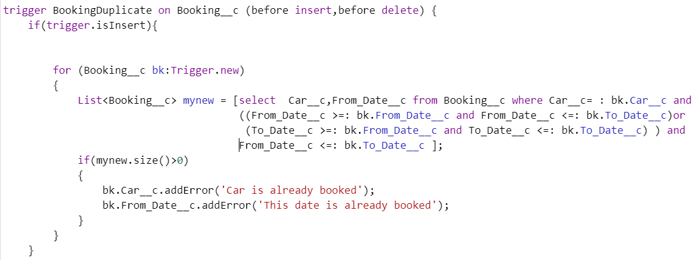
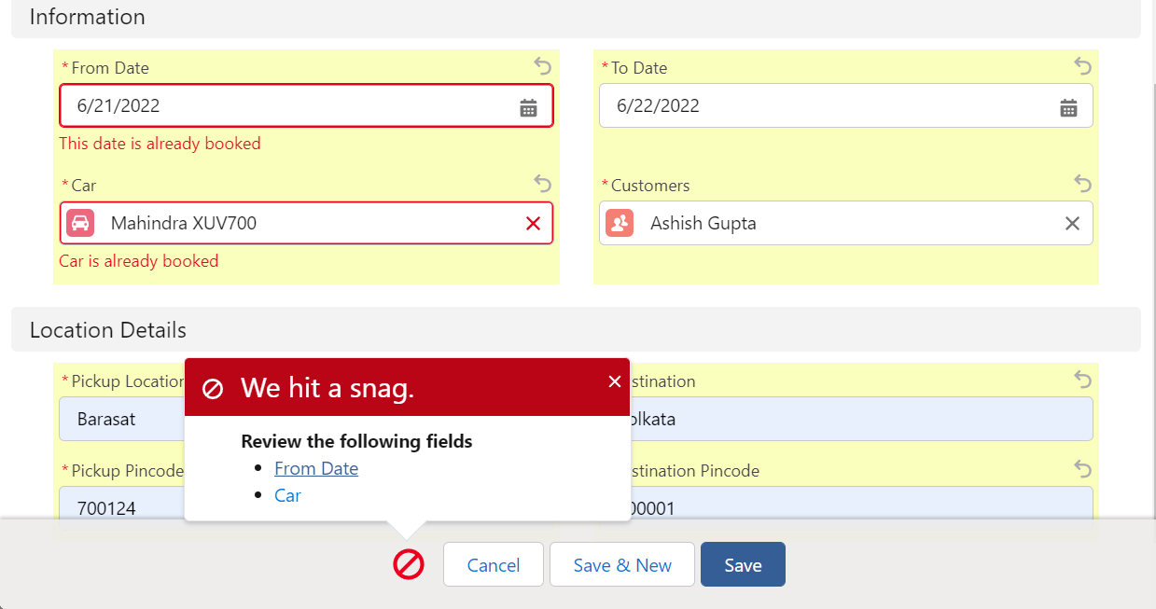
Duplicate Booking

Slide 15
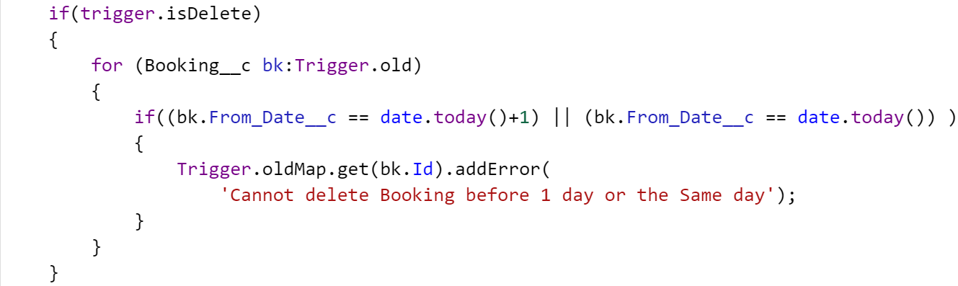
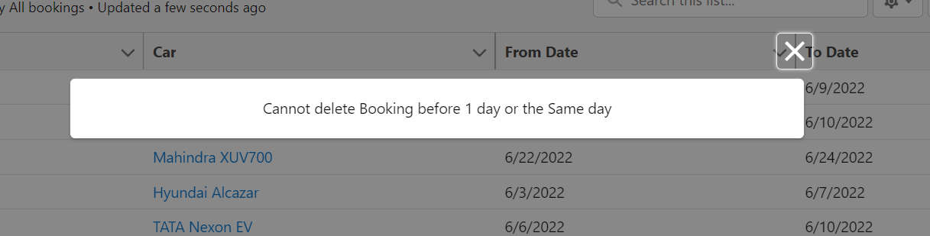
Delete Trigger

Slide 16











Functionality
Register and maintain Customer records.
Prevent Duplicate Customer records
Allows the customer to rent available cars
Create and maintain Car records.
Search Car details
Customers cannot give Present day as Booking date.
For Booking, ‘To-Date’ always greater than ‘From-Date’
Customers feedback on
overall experience.
Report is generated based on the customer's feedback.
Prevent Duplicate Booking records

Slide 17
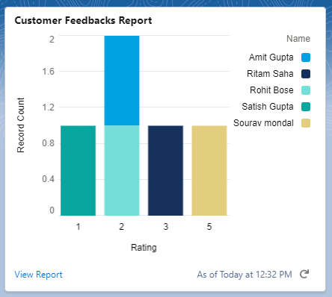
Reports
Visualize Customer Feedbacks based on the ratings provided by Customers

Slide 18
Future Scope
Query raise & Support
Payment gateway integration
UI improvement
Chatbot development
Increase Automation to improve efficiency.
Conclusion

Slide 19
THANK YOU!

